Slide 1
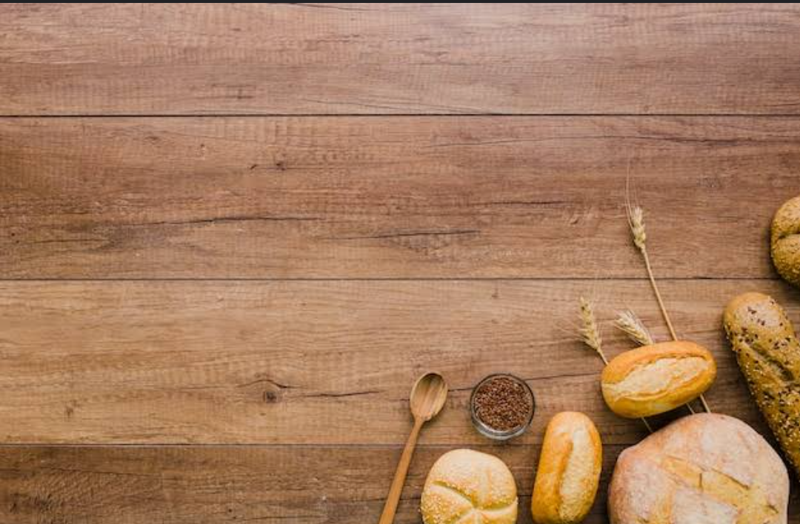
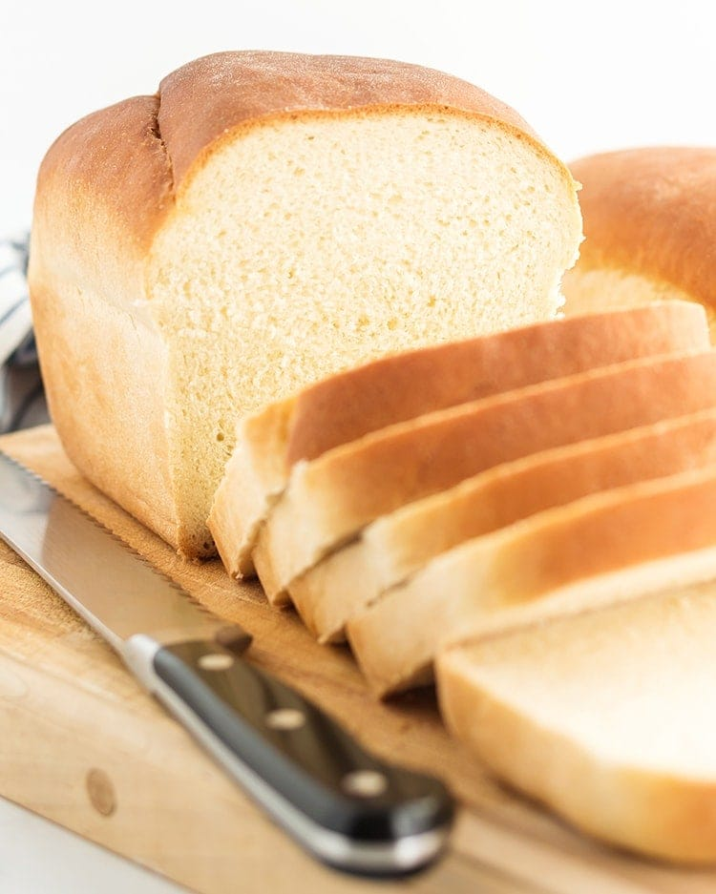
PROJECT ON ENTREPRENEURSHIP
DEVELOPMENT OF BREAD
MANUFACTURING INDUSTRY
GUIDED BY
DR. APURBA GIRI (Assistant Professor and Head)
AYAN MONDAL (Assistant Professor)
Dept. of Nutrition
PRESENTED BY
PALAS KUMAR MANDAL
ROLL - 0447
B.VOC (FOOD PROCESSING, 6th sem)
Dept. of Nutrition
MUGBERIA GANGADHAR MAHAVIDYALAYA

Slide 2
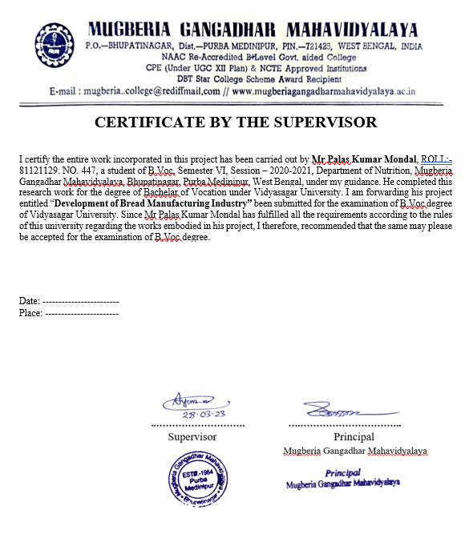

Slide 3


PK PVT.LTD
PK PVT.LTD
BAJKUL: PURBA MEDINIPUR: 721655
http://www.pkbakeing.com
email-feedback@pkbread.com
9883343257

Slide 4

CONTENT
Why I chose bread business
Market study
Source of Capital and Licence
Raw material use in bread industry
Name of Machinery & it's cost
Plant layout
Processing of bread
Marketing

Slide 5

WHY I CHOOSE BREAD BUSINESS
Baked items have a sustainable market in my location.
A bakery business promotes creativity.

Slide 6
MARKET STUDY

Slide 7
SOURCE OF CAPITAL & LICENCE
CAPITAL -
PRADHAN MANTRI MUDRA YOJANA (PMMY)
1) Scheme Details
The PMMY was launched by the Hon'ble Prime Minister onth April 2015. MUDRA loans are given to income generating micro/small business entities engaged in:
Trading
Manufacturing
Services sector
Activities allied to agriculture, egpaciculture

Slide 8
2) Eligible Borrowers
Indrida's
Proprietary Concern
Partnership Firm
Private Limited Company
Ensities of Any Other Legal Forms
3) Private bank loan

Slide 9

LICENSES-
REGISTRATION OF BUSINESS
NOC PAPER
TRADE LICENCE
GST
FSSAI
RAGISTRATION FOR TRADEMARK

Slide 10
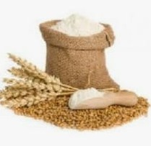
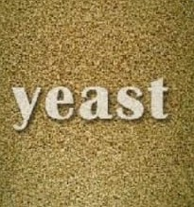

RAW MATERIAL USE IN BREAD
INDUSTRIES
1) FLOUR -
Bahalia, Mahisagote, Contal, Purba Medinipur, Medinipur, West Bengal
2)YEAST-
B-3, Revati Neelachand, Abasan 98, Rajdanga Kasba, Kasba, Kolkata, West Bengal, India
3)WATER-
Ground Water

Slide 11
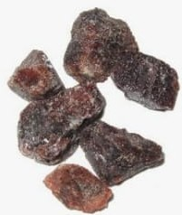
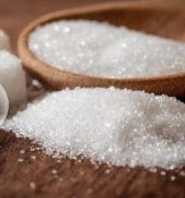
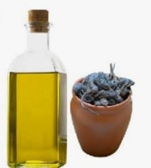
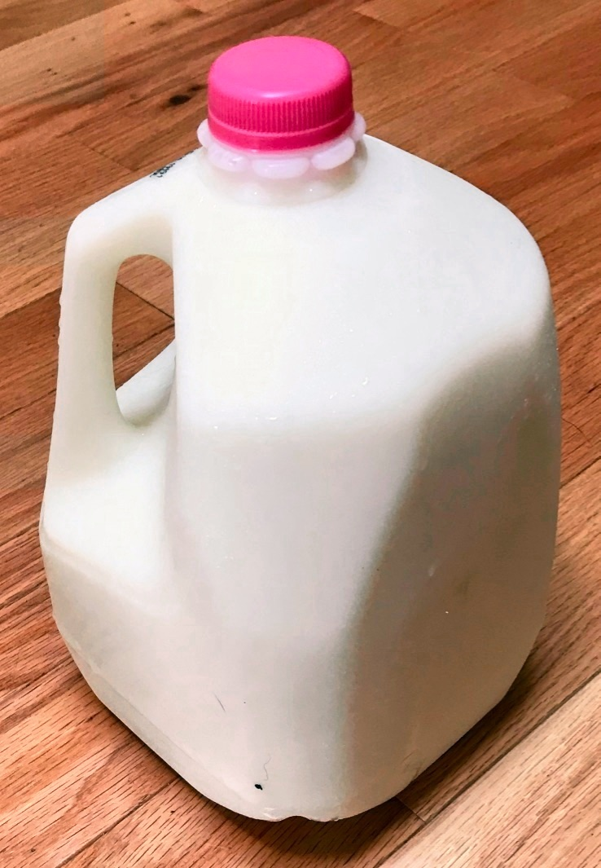
4) SALT-
156/28, Dunlop Bridge, Bt Road, Kolkata, West Bengal, India
5) SUGAR-
Leopoldlaan 121, 8430 Middelkerke, West Flander,Belgium
6) FAT-
23/49/31,Halisahar Nabanagar Road 1,Halisahar, North 24 Parganas, West Bengal, India
Nandan Housing Complex, Dankuni Station Rd, Dankuni, West Bengal 712311
7) MILK-

Slide 12
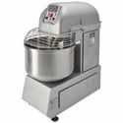
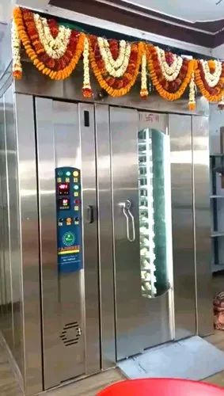
NAME OF MACHINERY & IT'S COST
Spiral mixture - 4.5 L
Rotary oven ,,4.3 L

Slide 13
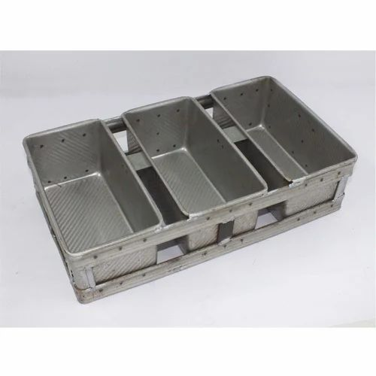
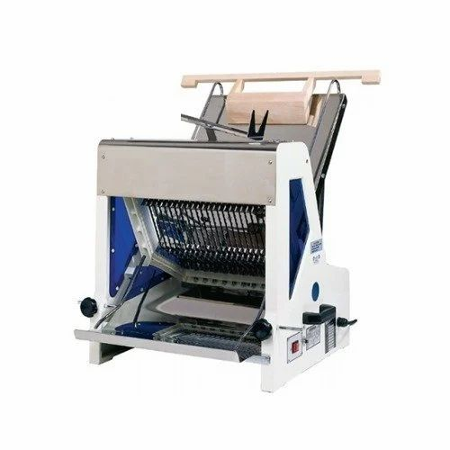
Moulder 50,000 /-
Slicer 44,000/-
http://m.indiamart.com/impcat/bread-making-machine.html

Slide 14
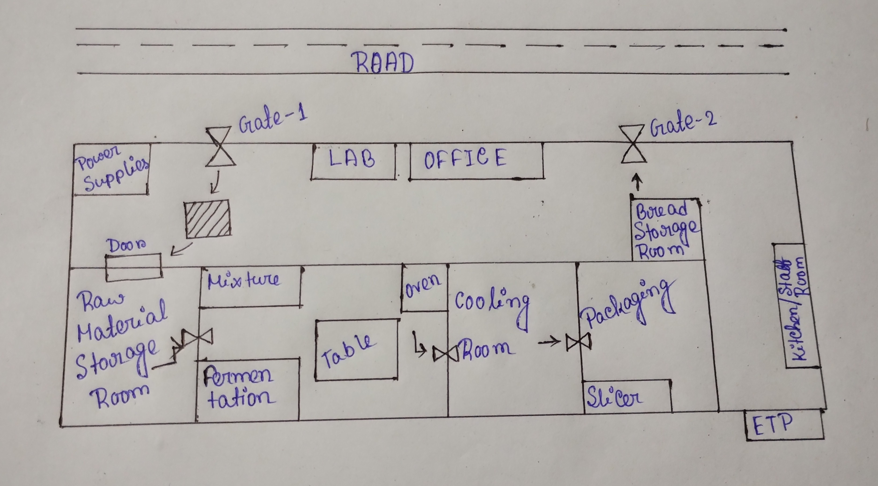
PLANT LAYOUT

Slide 15
PROCESSING OF BREAD
SIEVING OF FLOUR
DOUGH MAKING
DIVIDING ROUNDING
FERMENTATION
PROFING
BACKING
SLICING
COOLING
PACKAGING

Slide 16


MARKETING
WHOLESALERS
RETAILERS
RESTAURANTS
HOUSEHOLD
ONLINE
OTHERS

Slide 17

THANK
YOU

